Slide 1

KEYLOGGER
Presented by
SHARON SAJEEV
B.E.COMPUTER SCIENCE
GRACE COLLEGE OF ENGINEERING

Slide 2
OUTLINE
Problem Statement
Proposed System/Solution
System Development Approach
Algorithm & Deployment
Result
Conclusion
Future Scope
Reference

Slide 3
Describe the need for monitoring and tracking keystrokes without the user knowledge. Discuss the need for discreet monitoring of user activity , particularly in environment where security or productivity is a concern. Highlight scenarios such as employee monitoring , parental control or forensic investigation where the ability to capture keystroke could be beneficial.
Problem Statement

Slide 4

Proposed System/Solution
Introduce the concept of a keylogger as a solution to the stated problem.
Explain the concept of a keylogger as a software tool designed to capture and record keystroke made by a user on a computer or mobile device.
Empathize the stealthy nature of keyloggers , which operate silently in the background without the user’s knowledge.

Slide 5

System Development Approach
Detail the programming languages and technologies commonly used to develop keyloggers such as C/C++ , Python or .NET frameworks.
Discuss the choice between creating a user-mode or kernel-mode keylogger , each with its own advantages and limitations.

Slide 6

Algorithm & Deployment
The algorithm used by the keylogger to capture and store keystrokes and how it’s deployed on various operating systems.
Algorithm selection:
Keyloggers use algorithm to intercept and record keystrokes.
Data input:
The intercepted data is then logged , manipulated or analyzed as needed.
Training process:
This involves collecting labeled keystroke datasets , training ML models to recognize patterns.
Prediction process: Predict based on learned patterns , potentially identifying users , detecting suspicious activity or categorizing keystrokes.

Slide 7
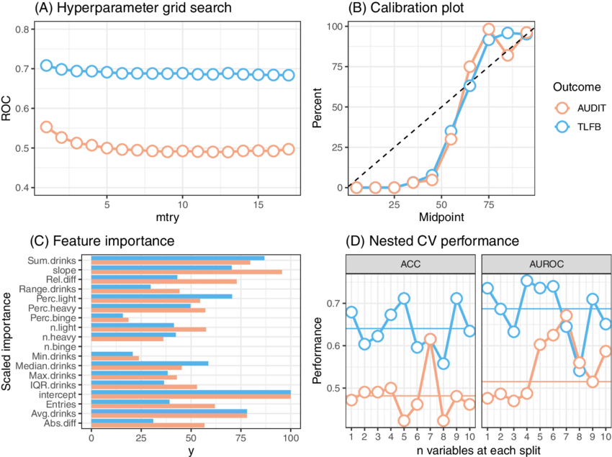
Demonstrating the captured keystrokes in action
Results

Slide 8
Conclusion
Reflect on the ethical and legal considerations surrounding the use of keyloggers , acknowledging the potential for abuse and invasion of privacy.
Highlight the importance of transparency and informed consent when deploying keylogging software in any context.

Slide 9
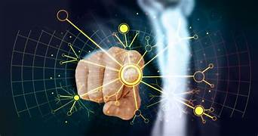
Explore potential advancements in keylogger technology , such as machine learning algorithms for more accurate keystroke recognition or integration with other monitoring tools for comprehensive user activity tracking. Potential applications beyond keystroke logging such as capturing mouse movements , clipboard content or application usage patterns.
Future Scope

Slide 10

"Deep Learning for Demand Prediction: A Survey" by X. Liang, L. Zhao, X. Jiang, and Y. Dong. (IEEE Transactions on Industrial Informatics, 2020) "A Comprehensive Review on Demand Prediction in Bike Sharing Systems" by S. Abhishek, A. Vijayaraghavan, and G. Sukumar. (2019 International Conference on Data Science and Communication, ICDSCom) "Time Series Forecasting with Deep Learning: A Survey" by Z. Zhang, Y. Zhao, and Y. Wang. (arXiv preprint arXiv:1809.04356, 2018) "A Comparative Study of Time Series Forecasting Methods for Predictive Maintenance" by A. Sharma, A. Mathur, and S. Tiwari. (2019 IEEE 16th India Council International Conference (INDICON), IEEE) "Machine Learning for Demand Forecasting: A Review" by C. McArdle, J. Vinué, and P. Mues. (International Journal of Forecasting, 2020) "A Comprehensive Survey on Machine Learning Techniques for Time Series Forecasting" by B. Amine, R. E. Al-Dujaili, and F. Fnaiech. (Journal of Big Data, 2021) "Feature Engineering for Machine Learning: Principles and Techniques for Data Scientists" by A. Zheng and A. Casari. (O'Reilly Media, 2018) "Model Evaluation, Model Selection, and Algorithm Selection in Machine Learning" by C. Blake and C. J. Merz. (1998) These sources cover a range of topics relevant to developing a solution for demand prediction, including deep learning, time series forecasting, machine learning techniques, data preprocessing, and model evaluation.
References

Slide 11


